Slide 1
Stack
Topic/Course
Sub-Topic (Example: name of college)
Notes:
Cover Page
Font: Nunito Sans
Primary colors: Black, White and Red (#F05136)
General Instruction:
Don’t edit this PPT (keep it for future reference)
Copy paste the required slide into your PPT. Format it there.
Write less, talk/present more
Use the font Nunito Sans Regular. You can download it from google fonts (https://fonts.google.com/specimen/Nunito+Sans).
Don’t change the size and/or positions of headings, texts, unless absolutely necessary. (minimum size: 20)
The size of the image must be adjusted according to the text. (try to make it look visually attractive)
1 image per slide. No more than 4 points per slide.

Slide 2
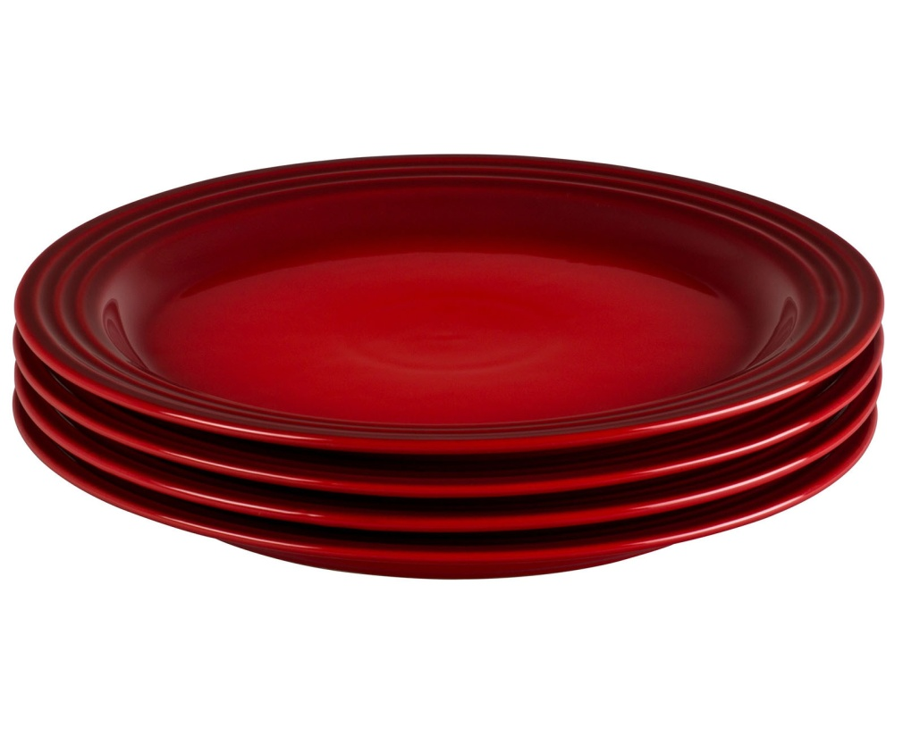
Stack

Slide 3
Stack
Stack follows Last In First Out (LIFO).
The last item to be inserted into a stack is the first one to be deleted from it.
Both insertion and removal are allowed at only one end.
Notes:
Title + Bullets
No more than 4 points. Please use another similar slide incase you have more points.

Slide 4
Stack
push() function - insert new elements
pop() function - remove an element
peek() function – top element of the stack
Overflow state - when it is completely full
Underflow state - if it is completely empty.
Notes:
Title + Bullets
No more than 4 points. Please use another similar slide incase you have more points.

Slide 5

Push and Pop
3
1
2
2
1
3
Push
Pop
Top Of the Stack = -1
Initially
Top Of the Stack
Means, the Stack is empty.
TOP=
-1
0
1
Push and Pop
2
Notes:
Stack is an ordereStack is an ordered list of similar data type.
Stack is a LIFO structure. (Last in First out).
push() function is used to insert new elements into the Stack and pop() is used to delete an element from the stack. Both insertion and deletion are allowed at only one end of Stack called Top.
d list of similar data type.
Stack is a LIFO structure. (Last in First out).
push() function is used to insert new elements into the Stack and pop() is used to delete an element from the stack. Both insertion and deletion are allowed at only one end of Stack called Top.
Stack is said to be in Overflow state when it is completely full and is said to be in Underflow state if it is completely empty.

Slide 6
Expression Evaluation
Infix Notation
To add A, B, we write A+B
Prefix Notation
To add A, B, we write +AB
Postfix Notation
To add A, B, we write AB+
Notes:
Title + Bullets
No more than 4 points. Please use another similar slide incase you have more points.

Slide 7
Infix Notation
The term infix goes between the operands
A + B
Evaluate:
3+(4*5)
3+(4 * 5) = 3 + 20 = 23
Infix notation requires parenthesis
Notes:
Title + Bullets
No more than 4 points. Please use another similar slide incase you have more points.

Slide 8
Prefix Notation
The term prefix goes before the operands
+A B
Evaluate:
= +3 * 4 5
= + 3 * 4 5
= + 3 20
= 23
Notes:
Title + Bullets
No more than 4 points. Please use another similar slide incase you have more points.

Slide 9
Prefix Notation
Evaluate:
= * + 3 4 5
= * + 3 4 5
= * 7 5
= 35
Prefix notation does not require parenthesis
Notes:
Title + Bullets
No more than 4 points. Please use another similar slide incase you have more points.

Slide 10
Postfix Notation
The term postfix goes after the operands
A B+
Evaluate:
= 3 4 5 * +
= 3 4 5 * +
= 3 20 +
= 23
Notes:
Title + Bullets
No more than 4 points. Please use another similar slide incase you have more points.

Slide 11
Postfix Notation
Evaluate:
= 3 4 + 5 *
= 3 4 + 5 *
= 7 5 *
= 35
Postfix notation does not require parenthesis
Notes:
Title + Bullets
No more than 4 points. Please use another similar slide incase you have more points.

Slide 12
Infix to Postfix Notation
( ( ( A + B) * ( C + D) ) / (F + G) )
Stack :
Output :
(
(
(
)
(
)
+
)
/
+
)
*
A
B
+
C
D
+
*
F
G
+
/
Notes:
Title + Bullets
No more than 4 points. Please use another similar slide incase you have more points.

Slide 13
Evaluation of Postfix
Precedence of operators:
‘$’ or ‘^’ Highest Precedence
‘*’ or ‘/’ High Precedence
‘+’ or ‘-’ Low Precedence
‘=‘ Lower Precedence
‘(‘ or ‘)’ Lowest Precedence
Notes:
Title + Bullets
No more than 4 points. Please use another similar slide incase you have more points.

Slide 14
Evaluation of Postfix
1 2 * 3 4 + 5 – +
4
2
5
1
3
=
7
2
2
+
*
-
Evaluate
Operand,
Push into stack
Operator,
Pop top two operands
Push into stack
Notes:
Title + Bullets
No more than 4 points. Please use another similar slide incase you have more points.

Slide 15
Evaluation of Postfix
1 2 * 3 4 + 5 – +
=
4
+
Evaluate
Print the top of the stack
Operator,
Pop top two operands
Push into stack
2
2
Notes:
Title + Bullets
No more than 4 points. Please use another similar slide incase you have more points.

Slide 16

THANK YOU
Notes:
Thank you slide

